Slide 1

AOBA & AOBA Alliance
Utility Rate Case Update
April 8, 2026
This publication is intended as an information source for members of the Apartment and Office Building Association of Metropolitan Washington (“AOBA”) and participants in the AOBA Alliance, Inc. The content should not be construed as legal or other professional advice, and readers should not act upon information in this publication without professional advice. Copyright © 2026 AOBA. All rights reserved.

Slide 2

Agenda
Pepco
  Pepco DC - Formal Case No. 1176 Appeal Update and Member Impact
  Pepco Maryland– Case No. 9655 Reconciliation of MYP
  Pepco Maryland– Case No. 9820
Washington Gas
  Washington Gas Maryland– Case No. 9849
  Washington Gas Virginia – Case No. PUR-2025-00091

Slide 3
Formal Case No. 1176 Appeal
On March 5, 2026, the D.C. Court of Appeals vacated the District of Columbia Public Service Commission’s (“Commission”) orders approving Pepco’s 2024–2026 multiyear rate plan and remanded the matter for the Commission to conduct a trial type evidentiary hearing.
  We agree that this was a contested case which required the Commission to hold a trial-type evidentiary hearing under D.C. Code § 2-509(b),and that its failure to do so renders its orders unsustainable. We thus vacate the Commission’s orders approving Pepco’s 2024-2026 rate plan and remand this case for further proceedings. (Opinion, pages 2-3 March 5, 2026).
  Vacate means that the Order is no longer valid and is treated as if it never existed.
The Court held that the Commission improperly relied on a “legislative style” hearing despite the presence of multiple material factual disputes raised by the Office of the People’s Counsel (“OPC”) and the Apartment and Office Building Association of Metropolitan Washington (“AOBA”). Court of Appeals Decision

Slide 4
Court’s Key Holdings
The Court held this was a contested case under D.C. Code § 2 509(b), requiring an evidentiary hearing where material factual disputes exist and where parties must have the opportunity for cross-examination and presentation of testimony.
The Court found at least two disputes requiring such a hearing:
  Dispute over GT LV customer counts and BSA deferral balances:
    AOBA calculated roughly $8.8 million in under recoveries versus Pepco’s $57.8 million, a nearly $49 million discrepancy.
  Dispute over projected energy usage per customer:
    OPC’s expert argued Pepco’s load forecasts understated expected revenues, thereby inflating the revenue requirement.
These disputes involved fact intensive expert disagreements inappropriate for resolution solely via written submissions.

Slide 5
Court’s Key Holdings
Legislative style hearings were insufficient in this context.
Although the Commission has used such hearings in other matters, the Court clarified that they are only appropriate when disputes concern legal interpretation, not contested factual determinations. Here, the Commission’s decision to weigh expert testimony on paper—without cross examination—violated procedural requirements.
Importantly, the Court held “contrary to the Commission’s understanding, evidentiary hearings are the rule, not the exception.” (Opinion, page 17, March 5, 2026).

Slide 6
Court’s Key Holdings
The Commission failed to adequately explain its acceptance of Pepco’s Effective Rate Adjustment (“ERA”) and Bill Stabilization Adjustment (“BSA”) calculations.
The Court held that the Commission’s orders were conclusory and lacked the explanation necessary for meaningful judicial review, particularly regarding:
  Why Pepco’s BSA deferral calculations were accepted over AOBA’s;
  Why AOBA’s challenge to the ERA’s effect on GT LV customers was rejected;
  Why key discrepancies—such as the $49 million BSA variance—were not addressed.

Slide 7
Outcome & Implications
The Court Vacated Commission Order Nos. 22328 (approving the rate plan) and 22358 (denying reconsideration); and
Remanded the matter with instructions to hold a full evidentiary hearing consistent with D.C. Code
§ 2 509(b).
Implications
Pepco’s 2024–2026 multiyear rate plan is effectively invalidated pending further proceedings.
The Commission must now conduct a trial type evidentiary hearing, including expert testimony and cross examination, on disputed issues such as:
  Accurate GT LV class customer counts;
  Proper calculation of BSA deferrals;
  Validity of Effective Rate Adjustments;
  Forecasting methodology for customer usage and revenue.

Slide 8
Pepco Motion for Expeditied Evidentiary Hearing
On March 5, 2026, immediately after the Court’s opinion was issued, Pepco Filed a Motion for Expedited Evidentiary Hearing.
Pepco’s Motion requests the expeditious holding of an evidentiary hearing based on the record in Formal Case No. 1176.
Pepco states that existing rates should continue in effect, pending the outcome of the Commission proceeding.
Pepco Motion
On March 10, 2026, Pepco filed an amended Motion for Expedited Evidentiary Hearing.
Pepco Amended Motion

Slide 9
OPC Motion To Suspend Rates Under the MYP
On March 6, 2026, OPC filed to restore the original rates for distribution service in place prior to January 1, 2025, for Pepco.
Specifically, OPC moves that the distribution rate schedules in place prior to the issuance of Commission Order No. 223283 be restored immediately, and by no later than April 1, 2026, following the decision by the Court of Appeals for the District of Columbia
Furthermore, OPC moves that Pepco refund the rates charged to ratepayers from January 1, 2025, through the date the Commission restores the pre-existing rates.
OPC Motion

Slide 10
AOBA Motion To Restore and Refund Rates
AOBA filed a motion on March 9th, which was supported by the District of Columbia Government and the Office of the Attorney Geneal, requesting that the Commission issue an order effectuating the ruling of the Court of Appeals by providing the following relief:
  Vacate Order Nos. 22328 and 22358 consistent with the Court of Appeals decision to vacate;
  Direct Pepco to restore electric distribution rates to those in effect as of December 31, 2024, effective with the Company’s April 2026 billing cycle;
  Require Pepco to refund to ratepayers all charges collected in excess of the December 31, 2024, rates for the period January 1, 2025, through the date restored rates take effect, including interest.
  AOBA Motion

Slide 11
AOBA’s March 9th Motion
In its motion, AOBA argued that the result of Commission orders approving increased rates that have been declared improperly issued, are null and void. As a result of the Court of Appeals decision the orders subject to appeal (i.e., Order Nos. 22328 and 22358) have no legal force or effect. It is as if the decisions never existed.
Additionally, AOBA argued that as a result of the Courts decision, the legal foundation for the rates implemented pursuant to Order Nos. 22328 and 22358 has been invalidated. Such invalidation requires timely corrective action by the Commission to ensure compliance with the Court’s mandate to vacate those orders and to protect every District ratepayer from paying rates that have not been legally justified and adopted.

Slide 12
More Filings - Pepco, OPC & AOBA Cross-filed Responses to each other
On March 12th, Pepco filed its response to OPC and AOBA’s Motions to suspend rates.
Pepco argues that AOBA and OPC request to vacate the Commission orders is “administratively inefficient”, will “inhibit the Company's ability to invest in the District” and could create “whiplash and confusion” for customers.
Also on March 12th, OPC and AOBA filed a joint response opposing Pepco’s request for an expedited hearing and continuation of existing rates.
Pepco’s Response OPC and AOBA Joint Filing
On March 13th, Pepco filed a Motion for Leave to Respond and Limited Response to OPC and AOBA . Pepco March 13 2026 Motion
On March 19, 2026, OPC filed a Request to File Reply and Reply to Pepco to the OPC and AOBA Motions to Suspend Rates
OPC Motion of March 19, 2026

Slide 13
Next Steps- Hearings Scheduled
On March 27, 2006, the Commission issued Order 22806 which holds in abeyance the filings by AOBA and OPC to restore previous rates and issue refunds to customers. The Commission directed the Parties “to appear for a pre-hearing conference, participate in an evidentiary hearing resolving the genuine issues of material fact identified by the Court, and any additional issues filed pursuant to this Order.”
The Commission further directed the Parties to submit supplemental briefings, issues and a witness list by April 6^{th.}
The Order also establishes the Remand Procedural Schedule.
AOBA, OPC and DC Government all made multiple filings objecting to the requirements in Order 22806.
AOBA Statement of Issues DCG Statement of Issues OPC Statement of Issues
AOBA Brief DCG Filed Witness List OPC Brief OPC Motion To Stay

Slide 14
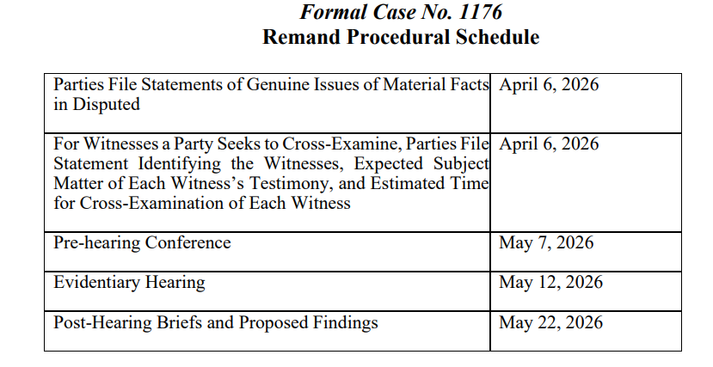
Next Steps- Hearings Scheduled

Slide 15
Filings in Response to Order No. 22806
In response to Order No. 22806, AOBA, OPC and DC Government filed Briefs and a Statement of Issues.
AOBA, OPC and DC Government also filed a Motion to Stay the Procedural Schedule.
The PSC is attempting to litigate only two issues in this remand proceeding and is thus essentially ignoring the Court’s Order to Vacate

Slide 16
Potential Next Steps at the Public Service Commission
At this time, the Commission should rule on the motions, responses and reply to the motions that are before them (i.e., AOBA, OPC and Pepco motions).
AOBA cannot predict how the Commission will choose to proceed.
However, the Commission should first restore distribution rates in effective prior to January 1, 2025 and refund to ratepayers all charges in excess of the pre-January 1, 2025 rates and collected from January 1, 2025 through the date the restored rates take effect.
After the Commission rules on all Motions, the Commission should establish a full evidentiary proceeding, including the filing of testimony, data requests, hearings and briefings.
It appears from Order 22806 that AOBA and OPC may need to return to the Court of Appeals.

Slide 17
Pepco Maryland Case No. 9655
Reconciliation Rate Year 3 Order No. 92264
Pepco’s Request:
• Pepco filed its reconciliation of rates for Year Three of the initial Pepco MYP (i.e., Case No. 9655) in which Pepco seeks to recover approximately $31.0 million in under-collected revenue. Pepco proposed to collect this revenue via the MYP Rider beginning May 1, 2025.
• Pepco alleges that the Company “under-recovered its approved RY3 Pepco MD Distribution revenue requirements by approximately $31.0 million.” Pepco attributes this under-recovery to “higher than projected rate base and higher than projected operating expenses.” Pepco proposed to collect the revenue deficiency over an 11-month period from April 1, 2025 through March 31, 2026 and add it to the already approved Year 2 Reconciliation.

Slide 18
Pepco Maryland Case No. 9655
Reconciliation Rate Year 3
AOBA’s Testimony:
• AOBA filed testimony on November 15, 2024 stating that Pepco did not meet its burden of proof and should not be allowed to recover any of its proposed $31.0 million requested increase. Additionally, AOBA’s testimony argued that in fact, Pepco has no Rate Year 3 revenue shortfall. The Company has recovered through rates the revenues that this Commission authorized for Rate Year 3, and any claimed revenue shortfall is due to Pepco’s substantial overspending of the Commission’s authorized Rate Year 3 revenue requirement.
• Further, AOBA’s testimony submitted that the Company’s failure to exercise reasonable cost control must not be rewarded. This Commission instructed Pepco to work within the lower revenue requirements the Commission approved in Order No. 89868.

Slide 19
Pepco Maryland Case No. 9655
Reconciliation Rate Year 3
On March 31, 2026, the PSC issued Order 92264 which reduced the $30.6 million of the reconciliation that Pepco requested, and approved a $13.36 million increase in revenues.
The reconciliation amount will be collected from ratepayers from April 1, 2026 through March 31, 2027. Pepco requested that the $30.6 million be recovered from May 1, 2026 through April 30, 2027.
The Commission clearly understood the testimony of AOBA and others and noted in its ruling that:
  While the Commission approved the base MRP, the Commission has repeatedly emphasized that MRP utilities should not expect full recovery of their reconciliation requests, and that rate affordability by customers should be a serious consideration – warning utilities that close adherence to budgets is a crucial consideration in addressing reconciliation requests.
Pepco Motion To Extend Period to Recover Reconciliation Charges

Slide 20
Pepco Maryland Case No. 9820
Application for a Rate Increase
Pepco filed an Application for Adjustment to its Retail Rates for the Distribution of Electricity for a $133 million rate increase in Maryland on October 14, 2025. New rates will be effective August 10, 2026.
Pepco’s request actually consists of two different rate applications, one based on an historical test year for $142.0 million increase, and the other based on a fully forecasted test year for $133.0 million increase. The first hearing was held November 18, 2025.
AOBA filed a Motion to Dismiss/Reject Pepco’s Application and OPC also filed a motion to reject Pepco’s application or portions thereof. Both motions were denied without prejudice.

Slide 21
Pepco Maryland Case No. 9820
On January 30, 2026, AOBA filed testimony from its expert witnesses recommending a smaller increase for Pepco of not to exceed $46.2 million based on Pepco’s inability to accurately forecast costs, excessive capital and reliability spending and an inaccurate revenue allocation between rate classes, with the GT_LV and MGT_LV rate classes receiving higher than average increases.
Bruce Oliver Case 9820 Testimony
Tim Oliver Case 9820 Testimony

Slide 22
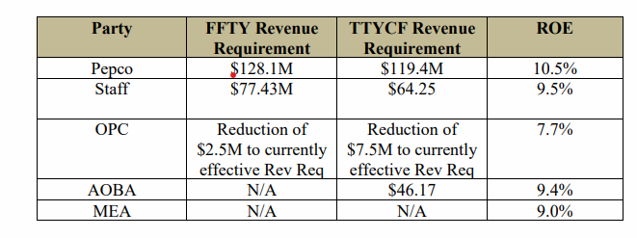
Pepco Maryland Case No. 9820
On March 11, 2026, Pepco filed rebuttal testimony in Case No. 9820.
The table below summarizes the Overall Revenue Requirements by Party
Pepco Rebuttal Testimony

Slide 23
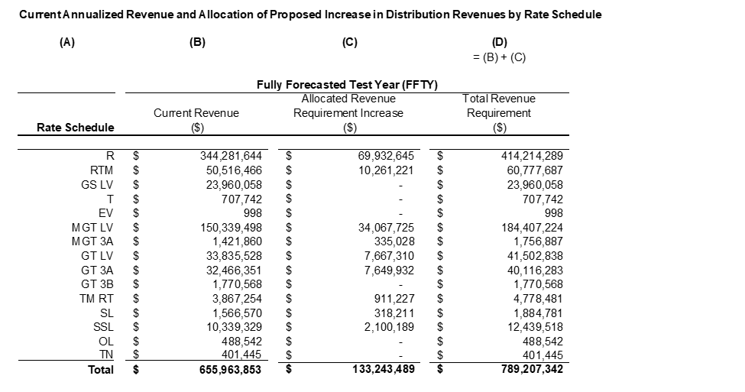
Pepco Maryland Case No. 9820
AOBA anticipates the rate increase for commercial customers between 23% -29%, if not more if Pepco’s full request is granted.
The allocation of the rate increase is shown below with approximately $80 million of the increase applied to residential rate payers.

Slide 24
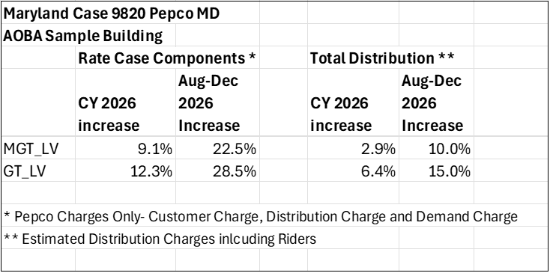
Pepco Maryland Case No. 9820
AOBA preliminarily reviewed a few sample accounts to calculate the impact on rates going forward for an MGT_LV and a GT_LV account.
The chart presents this in multiple formats and includes ONLY the three rate case components (customer charge, distribution charge and demand charge)
Budget impact for CY 2026 (assuming the rate increase begins in August 2026, seven months at current rates, four plus months at new rates)
Impact of the rate increase just for the months of August to December 2026.

Slide 25
Pepco Maryland Case No. 9820
For budget purposes, the MGT_LV building should expect an increase of 10% in their total distribution costs from Pepco for the months of August to December 2026 with an annualized total impact on 2026 budgets of approximately a 3% increase.
Your building could have different impacts based on your building size and load shape and other factors, including the other riders included in your Pepco bill.
What Does it All Mean?
Members should expect this new rate increase (Case No. 9820) to be implemented August 10, 2026, and adjust budgets accordingly. AOBA and AOBA Alliance are available to help with forecasts and impacts based on this initial filing.

Slide 26
Washington Gas Maryland Case No. 9849
On December 29, 2025, Washington Gas Light Company filed an application for an increase in revenue of $82.5 million in annual operating revenues based on a proposed 8.07% Rate of Return and a Return on Equity of 10.85%.
The proposed increase includes $15.4 million of revenue requirement from the transfer of STRIDE program costs to base rates. The new rates proposed would be effective on July 27, 2026.
Commercial customer classes would see approximately a 20% increase for those buildings that heat or cool using natural gas and Group Metered Apartment Heating and Cooling customer classes would receive increases of 25%.

Slide 27
Washington Gas Maryland Case No. 9849
Those increases would be for the Washington Gas distribution components only and do not include the gas supply charges.
Washington Gas’ estimates, including gas supply using the Purchased Gas Cost (“PGC”), show an increase between 10-18% for AOBA member buildings based on Washington Gas’ calculations.
AOBA has intervened in this case on behalf of AOBA members.
Case 9849 Schedule D

Slide 28
Washington Gas Maryland Case No. 9849
On March 31, 2026, AOBA filed the testimony of its expert witnesses in the case.
AOBA argued that Washington Gas’ rate base growth is outpacing its service growth, the rate base has increased 21.2% while customer count, actual throughput and demand grew between 1.7% and 4.1%.
AOBA also noted that Washington Gas’ Unaccounted For gas factor is substantially higher than the industry average and the Company has done little to reduce it.
AOBA recommends an increase of not more than $26.0 million, and an ROE of not more than 9.4%.
AOBA - Bruce Oliver Case 9849 Testimony
AOBA- Tim Oliver Case 9849 Testimony
OPC Testimony
Office of Staff Counsel Testimony

Slide 29
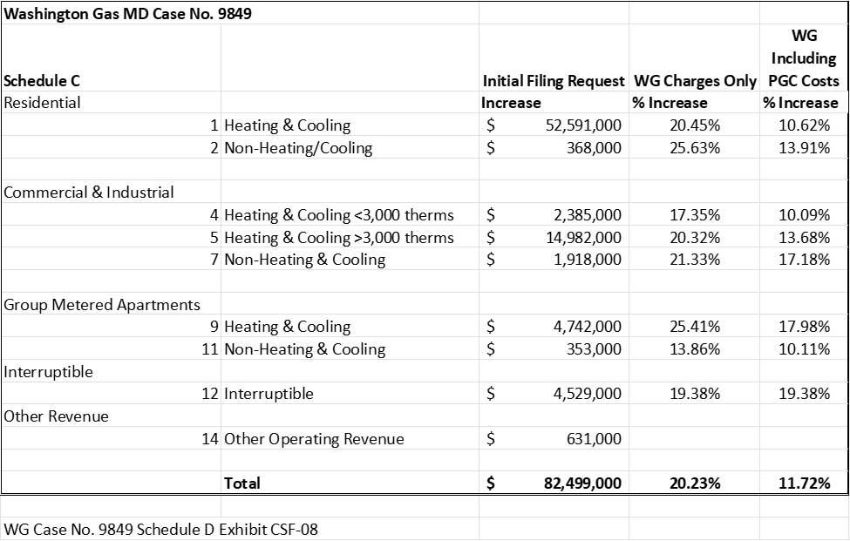
Washington Gas Maryland Case No. 9849

Slide 30
Washington Gas Maryland Case No. 9849
These estimates from Washington Gas are based on class averages. WG has proposed significant changes to the allocation of costs within each customer class which may cause significant variations in the impact on individual buildings.
Washington Gas’ Application states:
  “the non-residential customer classes’ current block rates are beginning a transition to a flat, single-rate structure. As part of this transition for all non-residential customers, the Company proposes to narrow the current differentials between block rates. In addition, for C&I and GMA customers that are currently on a three-block declining rate structure, the Company proposes to reduce the number of blocks to two blocks.”
This block rate change will likely impact large natural gas users significantly with the large increases in the 2nd level charges shown below.

Slide 31
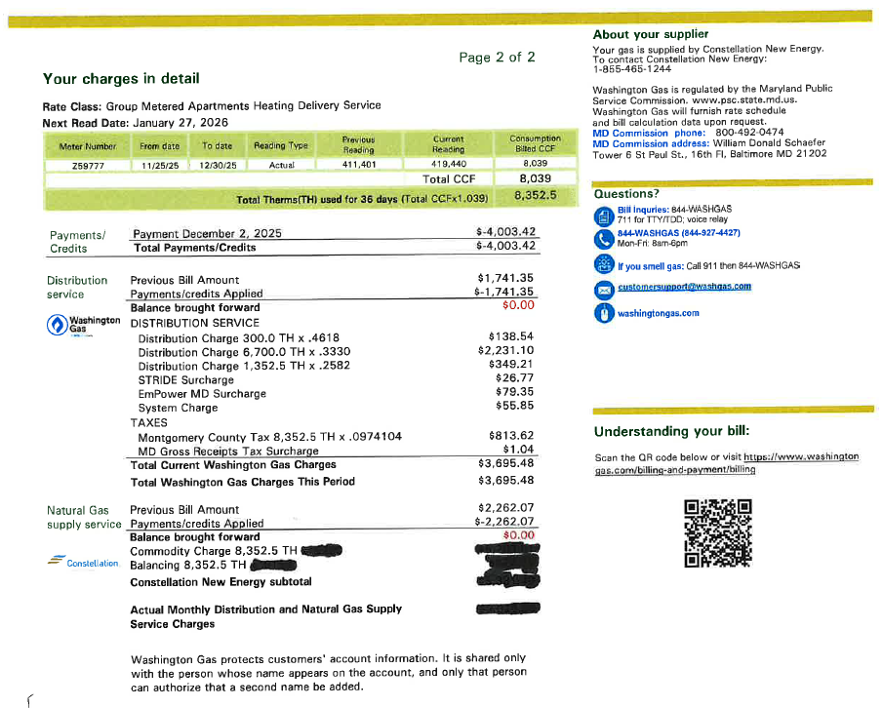
Washington Gas Maryland Case No. 9849

Slide 32
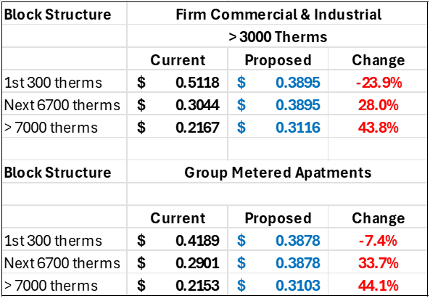
Washington Gas Maryland Case No. 9849
Under the old structure, the distribution rates declined on three blocks
WGL’s new proposal eliminates the third block and flattens the declining rate

Slide 33
Washington Gas Maryland Case No. 9849
Timeline
Maryland law requires that utility base rate increase applications be considered and decided within 210 days from the date the Application is filed for a historic test year rate case and decided within 10 months from the date an Application is filed for a multi-year rate case.
Therefore, Washington Gas rates will increase on and after July 27, 2026.

Slide 34
Washington Gas Virginia
Case No. PUR-2025-00091
Case No. PUR-2025-00091
On July 31, 2025, Washington Gas filed an application with the Virginia State Corporation Commission (“SCC”) requesting an increase in rates of $65.3 million, in addition to the transfer of $38.7 million of the costs of investments in infrastructure replacements made pursuant to the Company’s Steps to Advance Virginia’s Energy Plan (“SAVE Plan”) from the SAVE Rider to base rates, i.e., a total increase in rates of $104.1 million.
Washington Gas is requesting a Return on Equity of 10.85% and a Rate of Return of 7.96%.
The review of the revenue request anticipates that the average increase in distribution costs for members is 26-34%, which would result in an approximate 16-27 % increase in total Washington Gas Virginia bills beginning December 28, 2025, subject to refund.
In Virginia, by statute a requested rate increase becomes effective five months after the Application is filed with the SCC. Therefore, the rates as requested by Washington Gas became effective as of December 28, 2025, subject to refund when the SCC rules on the merits of the Application.

Slide 35
Washington Gas Virginia
Case No. PUR-2025-00091
AOBA Testimony
AOBA filed a Notice of Participation on October 14, 2025 and filed the testimony of an expert witness.
AOBA’s testimony recommended a 9.4% Return on Equity and a Rate of Return of 7.04%. Those two adjustments would eliminate $25 million of WGL’s request of $65.3 million.
AOBA Testimony
Impact on AOBA members:
The preliminary review of the revenue request finds that the average increase in distribution costs for members is approximately 26% - 34%, which would result in an approximate 16% - 27% increase in total Washington Gas Virginia bills (including the PGC) beginning December 28, 2025, subject to refund.
WG Rate Impact

Slide 36
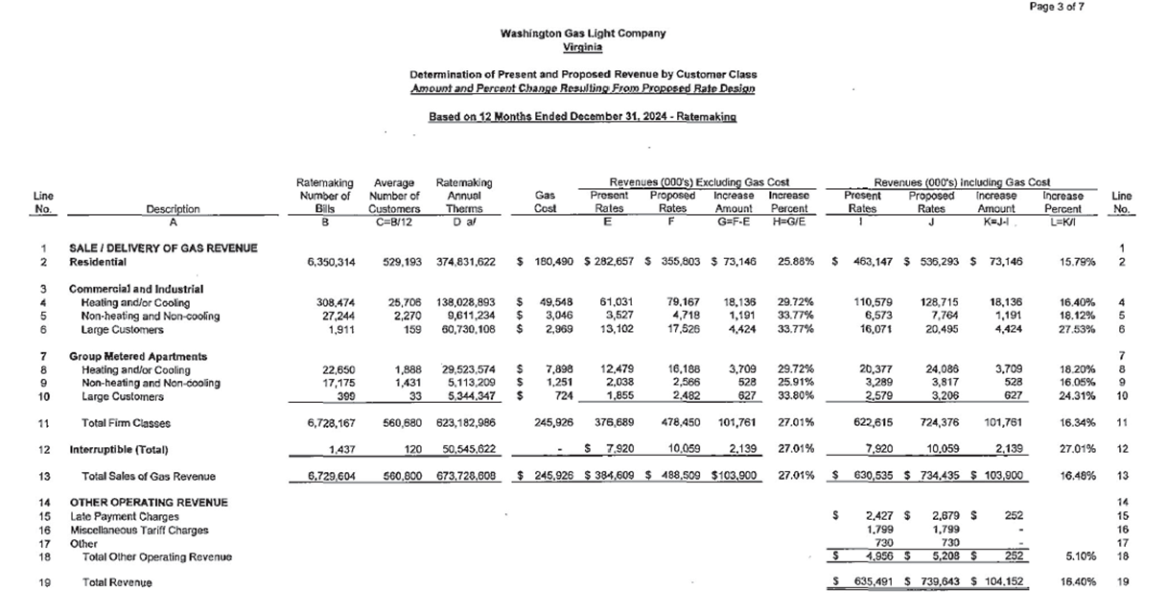
Washington Gas Virginia
Case No. PUR-2025-00091

Slide 37




Questions?
Frann G. Francis ffrancis@aoba-metro.org
MAILING ADDRESS
1025 Connecticut Avenue, NW, Ste 1005
Washington, DC 20036
PHONE NUMBER
(202) 296-3390
WEBSITE
www.aoba-metro.org
@AOBAMetro
@AOBAORG
linkedin.com/company/aoba-metro

Slide 38

Questions?
Kevin Carey kcarey@aoba-metro.org
MAILING ADDRESS
1025 Connecticut Avenue, NW, Ste 1005
Washington, DC 20036
PHONE NUMBER
(202) 296-3390
EMAIL
kcarey@aoba-metro.org
WEBSITE
www.aobaalliance.com

