Slide 1
MD SOS Procurement Schedule (For Demand Metered Commercial)
SOS bids are solicited separately for Type II Non-Residential customers.
SOS charges for Type II Non-Residential (e.g., smaller MGT-LV and MGT-3A accounts) are established for three-month periods:
June 1 – August 31
September 1 – November 30
December 1 – February 28
March 1 – May 31
Hourly Priced (Generation) Service (HPS) is offered for Type III Non-Residential Customers (i.e., MGT accounts with Over 600 kW of PJM Peak Load and all Rate Schedule GT customers).
With declining energy prices in recent years some large C&I customers have elected to use Hourly Priced Service (HPS).
In the current market with rising energy prices, HPS can result in a customer’s exposure to greater price increases.

Slide 2
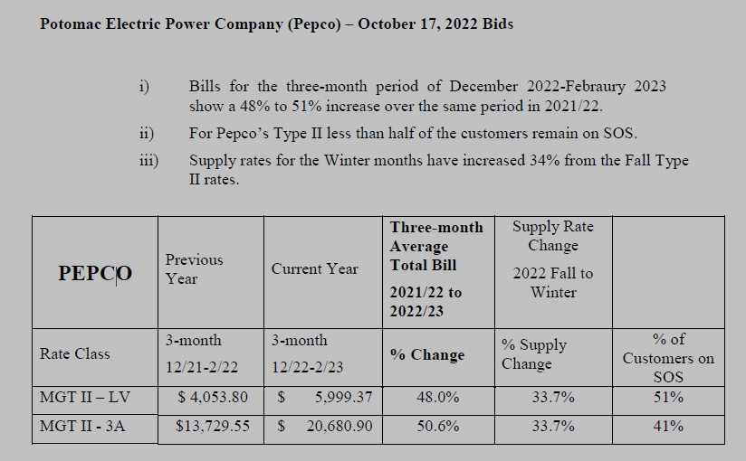
Pepco MD SOS Rate Increase

Slide 3
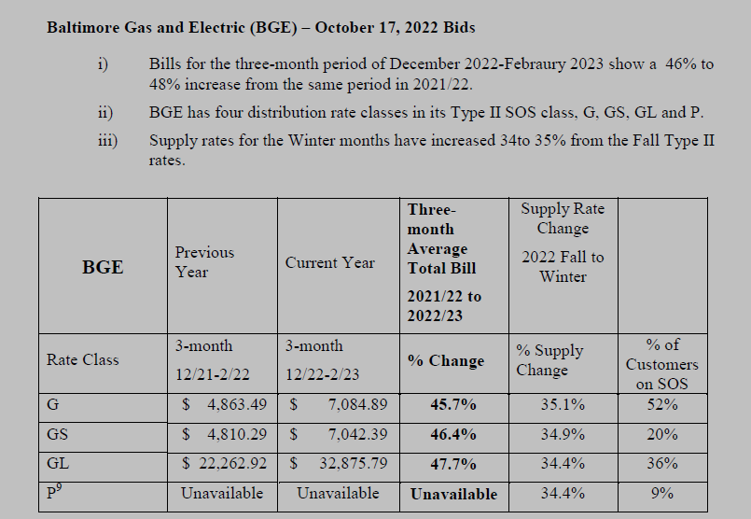
BGE SOS Rate Increase

Slide 4
DC SOS Procurement
Only procures SOS supply once a year for each customer category.
Solicitations are made in December and January for service starting the following June (i.e., for each PJM Delivery Year).
Procurements for Residential, MMA and Small Non-Demand Metered Commercial (e.g., Rate Schedules R, MMA, and GSND) for each delivery year are made in three tranches (with one-third of the annual SOS supply requirements procured in each of three annual solicitations).
SOS Procurements for Demand-Metered Commercial accounts (e.g., accounts served under rate schedules GSD, MGT-LV, GT-LV and GT-3A) are established through a single solicitation approximately 6 months prior to start of each PJM Delivery Year.

Slide 5
DC Standard Offer Service Procurement Schedule For Demand-Metered Commercial Classes (Rate schedules GSD, MGT-LV, GT-LV and GT-3A)

Slide 6
DC Standard Offer Service Procurement Schedule For Residential, MMA and Small Commercial Classes

